Slide 1
Chapter 10
Maintaining and Troubleshooting Your Network

Slide 2
Object
• Use hardware and software methods to monitor a network
• Perform backups over a network
• Solve a broad range of network problems
• Design a solutions strategy for network troubleshooting
http://fpt.edu.vn

Slide 3
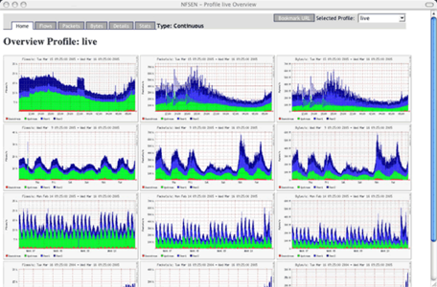
How to Monitor Your Network
Monitor network regularly after installation
Two-fold purpose for monitoring networks
  Become familiar with your network
  Quickly locate and troubleshoot problems
Monitoring tools to be presented
  Network-monitoring devices
  Basic network-monitoring tools in operating systems
  System Monitor
  Network Monitor
  SNMP service
http://fpt.edu.vn

Slide 4
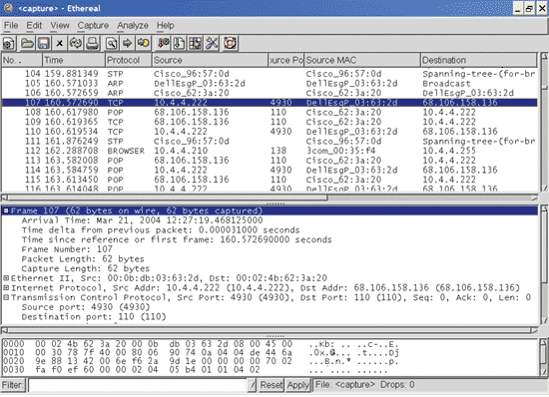
Network-Monitoring Devices
Range from voltage testers to protocol analyzers
Price is directly proportional to functionality
Examples of test and monitoring devices
  Voltmeter, multimeter, and optical power meter
  Cable scanner
  MAU analyzer
  Time domain reflectometer
  Wireless testing tool
  Protocol analyzer
http://fpt.edu.vn

Slide 5
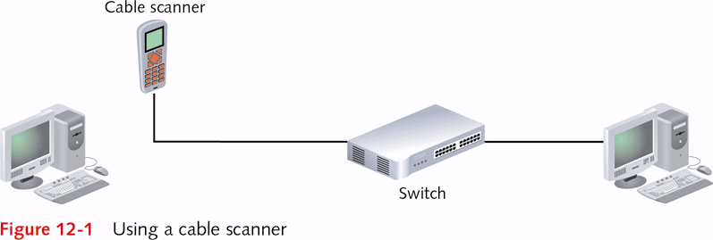
http://fpt.edu.vn

Slide 6
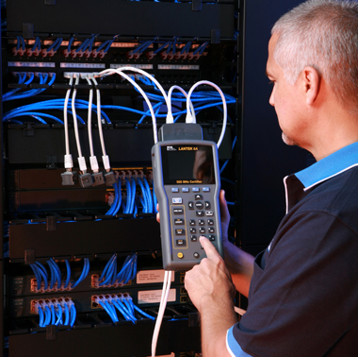
Using Basic Network-Monitoring Tools in Your Operating System
Cable-testing device not always needed
Basic information provided by operating system
  Status of network connection
  Statistics of network performance
Presentation of basic tools to follow
http://fpt.edu.vn

Slide 7
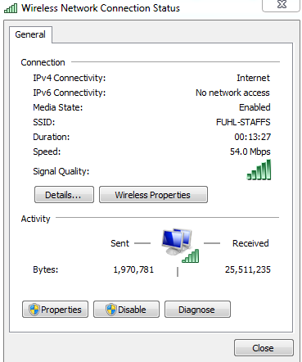
Using the Windows Connection Status Dialog Box
A number of tasks that may be performed
  Verify connection of computer and its network segment
  Determine duration of the computer’s connection
  View the connection speed
  Determine the number of bytes sent and received
  Determine the IP address information
  View the strength and status of a wireless connection
  Repair a connection
Tool may be used on any network connection
  Examples: local area, wireless, and DSL connections
http://fpt.edu.vn

Slide 8
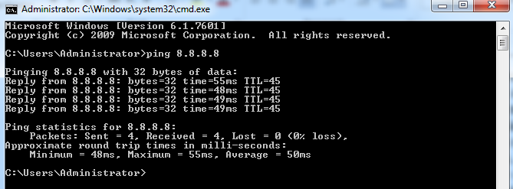
Using ping to Test a Network Connection
Typical uses for ping utility
  Testing the connection at the host computer
  Testing the connection of a target computer
  Testing connectivity between segments or networks
  Testing access over a WAN connection
  Testing to determine if a particular server is running
  Testing time for ping signal to make a round trip
Example: CFO cannot access shared folder
  ping tests path from CFO node to marketing node
  Successful ping shows problem not connection related
http://fpt.edu.vn

Slide 9
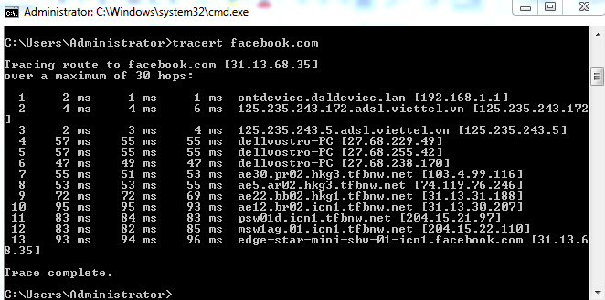
Using traceroute to Test a Network Connection
Supported by Windows and UNIX/Linux systems
  Enter tracert command in Windows console
  Enter traceroute in UNIX/Linux systems
Data returned by traceroute communication
  Number of hops between two nodes
  Nodes through which signal goes to reach destination
  Time for signal to reach destination
  Whether firewall is secure (should stop before firewall)
Employs UDP and ICMP (Internet Control Message Protocol)
http://fpt.edu.vn

Slide 10
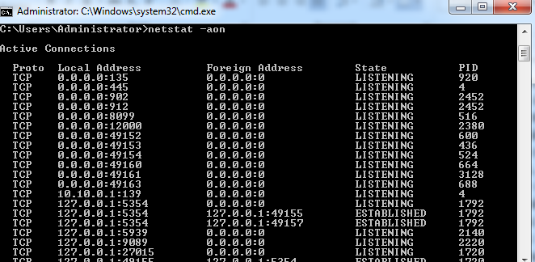
Using netstat
Purpose: gather data about TCP/IP communications
Available in Windows and UNIX/Linux systems
Communication information that may be viewed
  Protocol communications through TCP and UDP
  Network connections established by host computer
  TCP and UDP ports in use
  Routing table information
  Information about computers remotely logged onto host
  Multicast participation
  Data and communication errors
Switches enable you to view specific network data
http://fpt.edu.vn

Slide 11
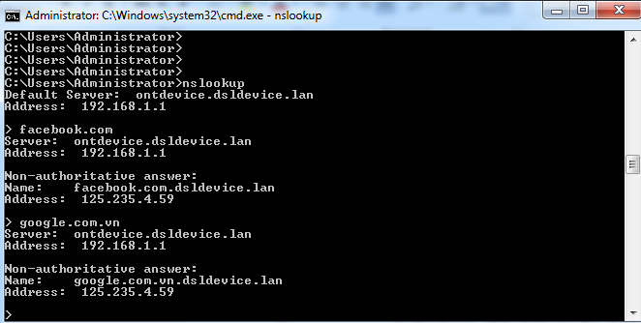
Using nslookup
Domain Name Services (DNS) is a TCP/IP service
nslookup available in Windows and UNIX/Linux
Some DNS questions can be answered by nslookup
Actions performed with nslookup
  Verifying that a DNS server is online and working
  Determining host name of a device if IP address known
  Determining the IP address if host name known
  Determining the primary DNS server on a network
  Querying the DNS database for information
Typical use of nslookup command
  Determines if ftp.gnu.org FTP site is working
http://fpt.edu.vn

Slide 12
Using System Monitor in Windows Server
Monitor hard disks, memory, and the processor
Also monitor network performance and protocols
Example 1: monitor network interface on server
  Track the number of bytes or packets received
Example 2: monitor IPv4 traffic
  Assess number of datagrams or fragmented packets
http://fpt.edu.vn

Slide 13
Capturing Data Using System Monitor
System Monitor located in Performance MMC
  Default view is in graph mode
Begin analysis by selecting object(s) to monitor
  One or more counters associated with object
  Counter measures quantity of object in some unit
    Example: TCPv4 counter tracks Segments Sent/Sec
Instance exists with different elements to monitor
  Example: when two or more NICs exist
Add Counters Dialog box
  Used to select objects to monitor, counters, instances
  Click Add button above tracking Window to open
http://fpt.edu.vn

Slide 14
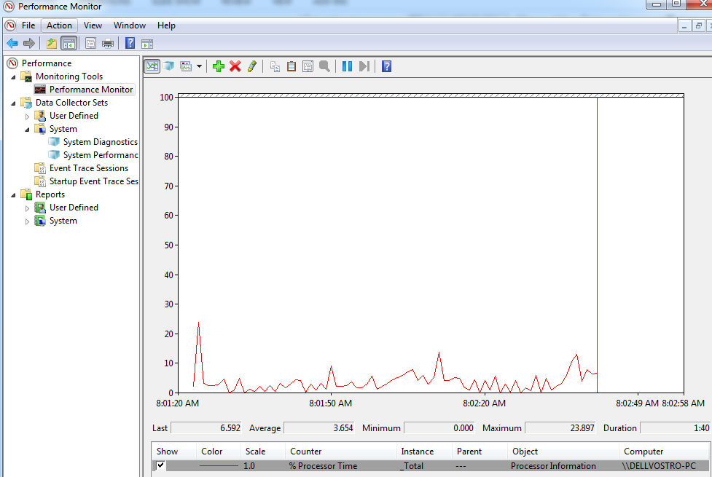
http://fpt.edu.vn

Slide 15
Using Network Monitor to Capture Data
Data detected and captured by Network Monitor Driver
  Packets or frames moving through NIC or WNIC
Network Monitor analyzes raw data
Network Monitor converts analysis into reports
Information tracked (list not inclusive)
  Percent network utilization
  Frames and bytes transported per second
  Transmissions per second
  NIC statistics
  Addresses of network stations
http://fpt.edu.vn

Slide 16
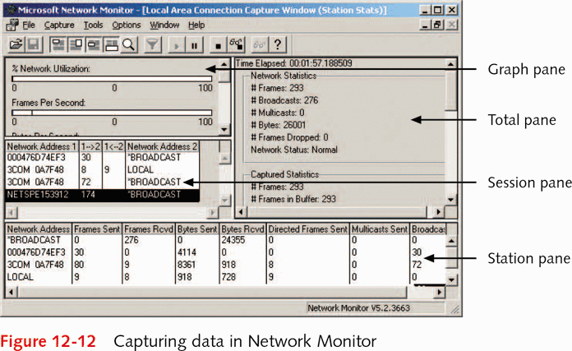
http://fpt.edu.vn

Slide 17
Using the SNMP Service in Windows Server
Perform tasks with agents and management systems
  SNMP agent responds to system's information request
  Systems and agents can be grouped into communities
Management tasks performed
  Configuring network devices
  Monitoring the performance of a network
  Locating network problems
  Monitoring network usage
Several operating systems/components use SNMP
  Examples: Windows Servers, DHCP servers
http://fpt.edu.vn

Slide 18
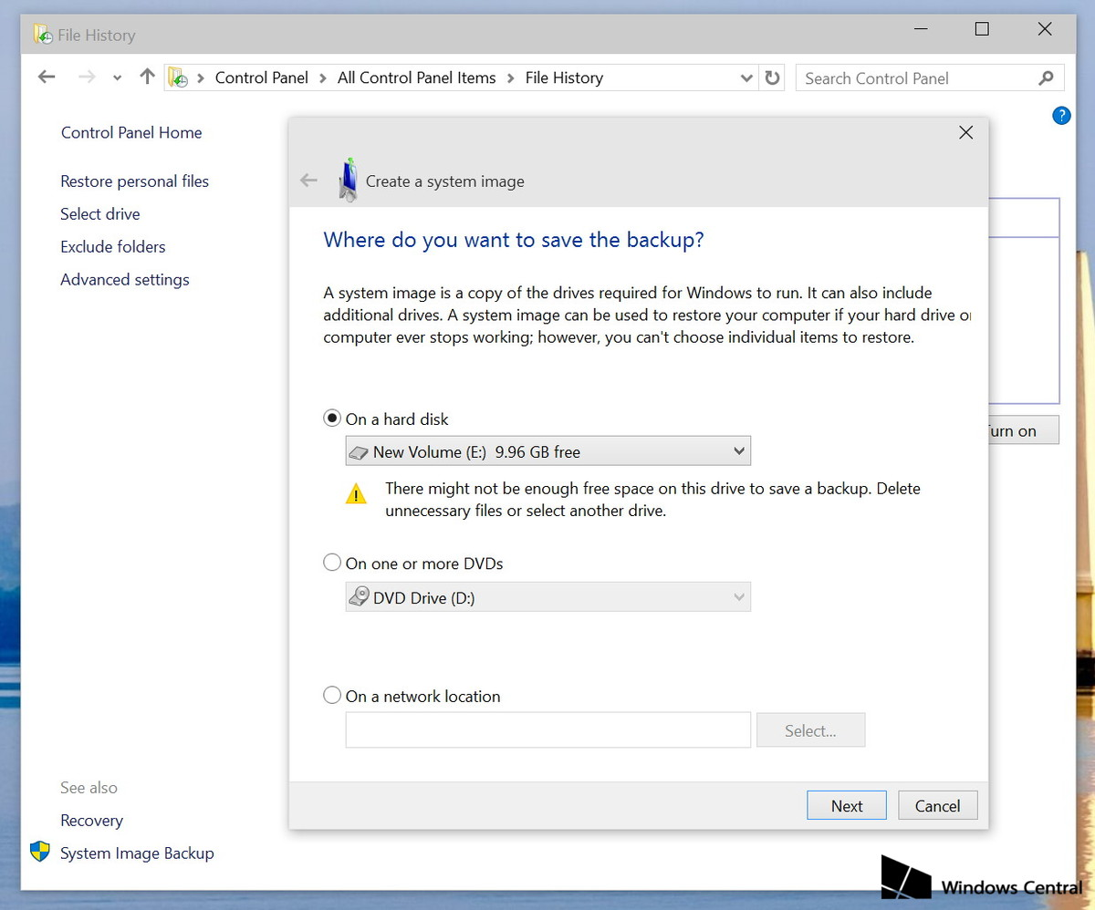
Backup Services in Windows 10 and Windows Server
Use Backup or Restore Wizard in System Tools
  Different combinations of backups allowed
  Ability to restore backed up information provided
Five backup options
  Normal: a file-by-file backup
  Incremental: backs up files marked with archive attribute
    Archive attribute removed from each file after the backup
  Differential: backs up all files marked archive attribute
    Does not remove the archive attribute
  Daily: backs up files changed on same day as backup
  Copy backup: backs up only specified files
http://fpt.edu.vn

Slide 19
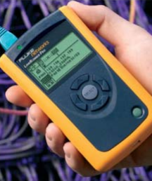
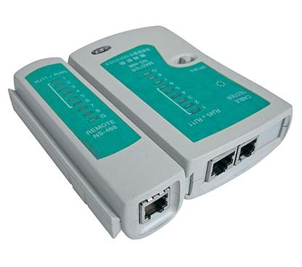
Solving Client, Server, and Network Connectivity Problems
Problems may be hardware or software related
  Examples: faulty cables, NICs, protocol setup
A number of tasks that may be performed
  Check for proper installation of NIC driver
  Check NIC driver version (should be current)
  Verify protocol setup, particularly IP addressing
  Ensure that NIC properties are configured correctly
  Ensure computers have unique name and IP address
  Check cable connection into NIC or reconnect cable
  Ensure nodes configured for same security (wireless)
http://fpt.edu.vn

Slide 20
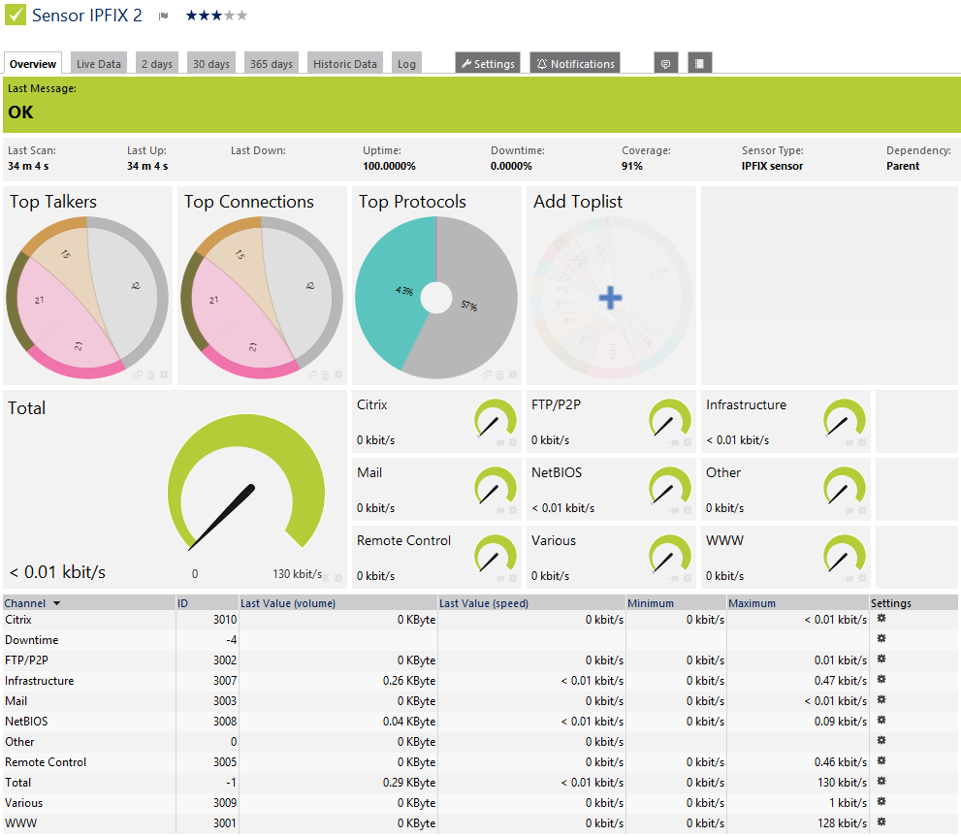
Hands-on Networking Fundamentals

Slide 21

Solving Wireless Problems
Four techniques
  Observe distance requirements for wireless technology
  Configure security in same way on all devices
    Enables all wireless devices to communicate
  Use same roaming protocol in each cell (if cell roams)
  Use WNICs and access points using same technology
    Supports best throughput
    Example: all devices using 802.11g
http://fpt.edu.vn

Slide 22
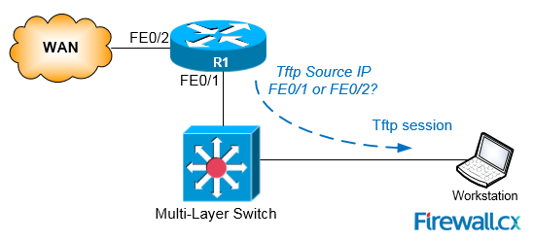
Backup and Restore Network Devices
BACKUP
CE_2#copy running-config tftp:
Address or name of remote host []? 64.104.207.171
Destination filename [ce_2-confg]? backup_cfg_for_my_router
!!
1030 bytes copied in 2.489 secs (395 bytes/sec)
CE_2#
RESTORE
Router#copy tftp: running-config
Address or name of remote host []? 64.104.207.171
Source filename []? backup_cfg_for_my_router
Destination filename [running-config]?
Accessing tftp://10.66.64.10/backup_cfg_for_my_router...
Loading backup_cfg_for_router from 64.104.207.171 (via FastEthernet0/0): !
[OK - 1030 bytes]
1030 bytes copied in 9.612 secs (107 bytes/sec)
CE_2#
Hands-on Networking Fundamentals

Slide 23

Q & A
http://fpt.edu.vn

